Slide 1
Software Construction and Development
Design Patterns in Java
Maria Kiran
Email: maria.kiran@ucp.edu.pk
Office: Building A, Faculty Hall F202
OFFICE HOURS: Tue, Wed, Thu (9:00 to 11:00)

Slide 2
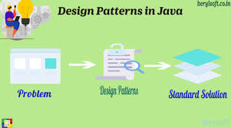
Design Pattern
Definition:
  A design pattern is a reusable solution to a common problem in software design.
  It provides a standard way to solve recurring design issues.
Key Points:
  Not a finished design or code, but a guideline.
  A blueprint to help structure and organize code effectively.

Slide 3
Why Are Design Patterns Important?
Improves Code Reusability
  Saves time and effort by reusing proven solutions.
Enhances Communication
  Creates a shared vocabulary for developers.
Provides Best Practices
  Offers tried-and-tested solutions.
Eases Maintenance
  Helps create flexible and maintainable designs.

Slide 4
Advantages of Design Patterns
Dis-Advantages of Design Patterns
Reusability
  Saves development time and effort.
Consistency
  Promotes uniform coding practices.
Efficiency
  Offers optimized solutions to common issues.
Readability
  Makes code easier to understand for others.
Complexity
  Can add unnecessary complexity if not used correctly.
Learning Curve
  Requires understanding of the pattern before use.
Overuse Risk
  Applying patterns unnecessarily may complicate the design.

Slide 5
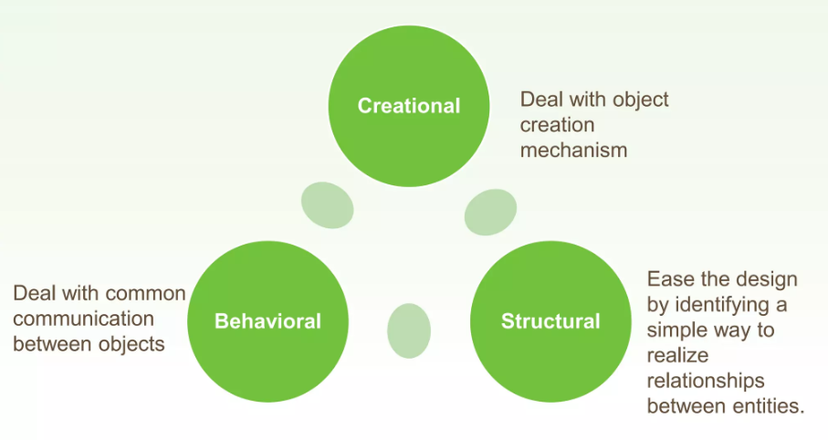
Classification

Slide 6
  Creational Design Pattern
Factory Pattern
Abstract Factory Pattern
Singleton Pattern
Prototype Pattern
Builder Pattern.

Slide 7
Structural Design Pattern
Adapter Pattern
Bridge Pattern
Composite Pattern
Decorator Pattern
Facade Pattern
Flyweight Pattern
Proxy Pattern

Slide 8
Behavioral Design Pattern
Chain Of Responsibility Pattern
Command Pattern
Interpreter Pattern
Iterator Pattern
Mediator Pattern
Memento Pattern
Observer Pattern
State Pattern
Strategy Pattern
Template Pattern
Visitor Pattern

Slide 9
Abstract Factory Pattern
Abstract Factory design pattern is one of the Creational pattern.
Abstract Factory pattern is almost similar to Factory Pattern is considered as another layer of abstraction over factory pattern.
Abstract Factory patterns work around a super-factory which creates other factories.

Slide 10
Elements of Abstract Factory Pattern
AbstractFactory - an interface that is used to create concrete factories.
  Client interact with this interface to access instances of ConcreteFactory concrete subclasses.
ConcreteFactory - A subclass of the Abstract factory, these concrete classes implement the operations/methods which are used to create concrete product objects.
AbstractProduct - The AbstractProduct class is used to declare an interface for a specific type of product object.
  It return the product subclass in relation to the ConcreteFactory which is currently being used to handle product instantiation.

Slide 11
Elements of Abstract Factory Pattern
ConcreteProduct - The concrete product is provided by it’s ConcreteFactory and defines the individual implementation details for the specified product through the implementation of its AbstractProduct interface.
Client - Only uses and has access to the AbstractFactory and AbstractProduct classes, making it completely unaware of the implementation details of the system.

Slide 12
Real-Life Example
Scenario: Ride Booking Application
Imagine you are developing a ride booking application for multiple cities.
When a user selects a city, the system automatically provides a complete ride package,
including:
  the type of ride
  the payment method
For example:
  In Karachi, most users prefer bike rides due to heavy traffic and usually pay via cash.
  In Lahore, users prefer car rides for comfort and mostly pay via card.
So, when a user selects a city, The system does not ask separately for ride type or payment method
Instead, it uses a factory for that city to create a matching set of objects (Ride + Payment)
  Karachi Factory → BikeRide + CashPayment
  Lahore Factory → CarRide + CardPayment
This ensures that the system always provides compatible and city-specific services without exposing creation logic to the user.

Slide 13
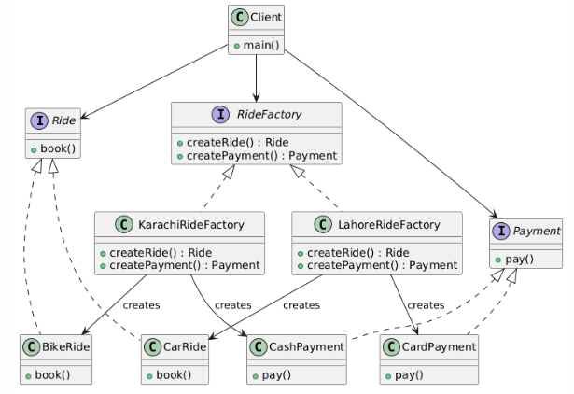

Slide 14
Decorator Pattern
Used to add new behavior dynamically without modifying the class.
Wraps the original object with additional functionality.
Follows “composition over inheritance”.
Example: Coffee + Milk + Sugar (adding features)

Slide 15
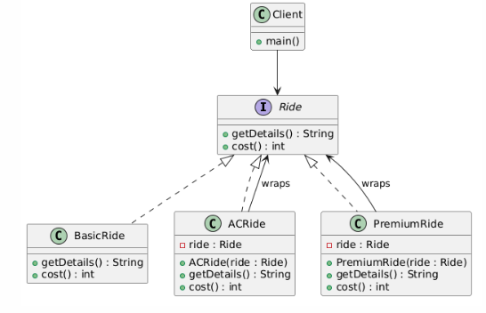

Slide 16
Observer Pattern
Defines a one-to-many relationship.
When one object (subject) changes, all dependents (observers) are notified.
Used in event systems (e.g., notifications, subscriptions).
👉 Example: Teacher notifies all students

Slide 17
